Slide 1
Introduction to Psychology
Memory processes -1
Sumitava Mukherjee

Slide 2
https://bit.ly/wateriitd1
13/09/21

Slide 3
Flying a lot
What would happen if you often fly to different countries across different time zones?
(20 flight attendants study - Cho, 2001)

Slide 4
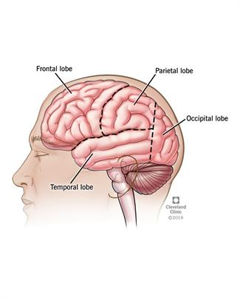
Effect of hormone - cortisol

Slide 5
Can you tell:
The capital of Brussels?
Capital of Greenland?
How many hours you slept on last Tuesday?
What does your best friend’s face look like?
How do you tie your shoes?

Slide 6
Introducing Memory
Means by which we can retain and draw on our past experiences to use information in the present
Conceptualized as a store and as a process
Three basic mechanisms: Encoding, Storage, Retrieval
Ways to study memory: Recall vs Recognition
Types of memory: Explicit vs Implicit

Slide 7
Recall VS Recognition
Recall the name of a comedian VS Which of these people is a comedian – x, yz, abc..
Types of recall tasks for the stimuli
((apple-S, ball-H, cat-G, dog-T, elephant-X))
  Serial recall task – order matters
  Free recall – random order
  Cued recall – One cue given

Slide 8
Recognition
Easier than recall
Example: Match-pairs easier than fill-blanks
More complex heterogeneous sets

Slide 9
Recognition
Easier than recall
Example: Match-pairs easier than fill-blanks
More complex heterogeneous sets

Slide 10
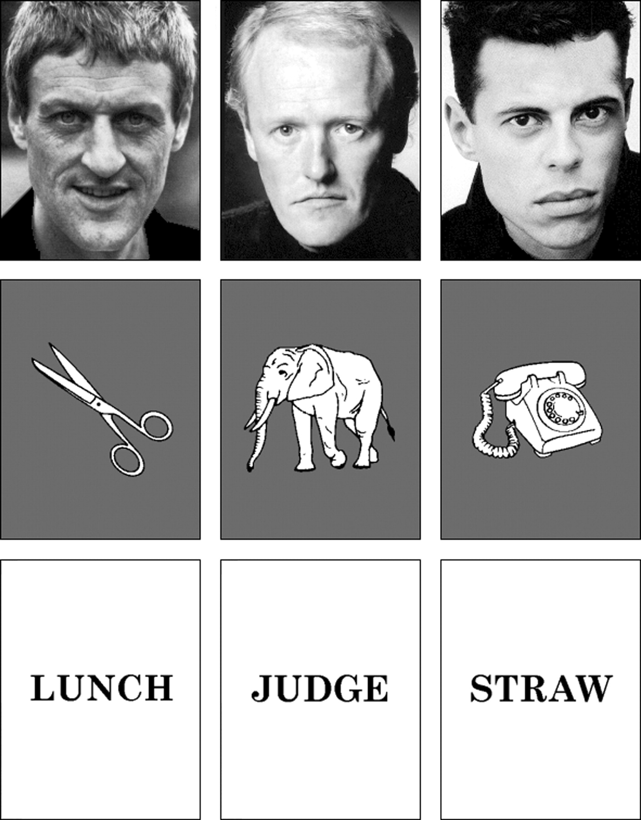
Recognition memory: complex

Slide 11
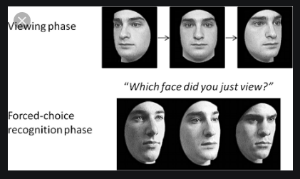
Recognition memory

Slide 12
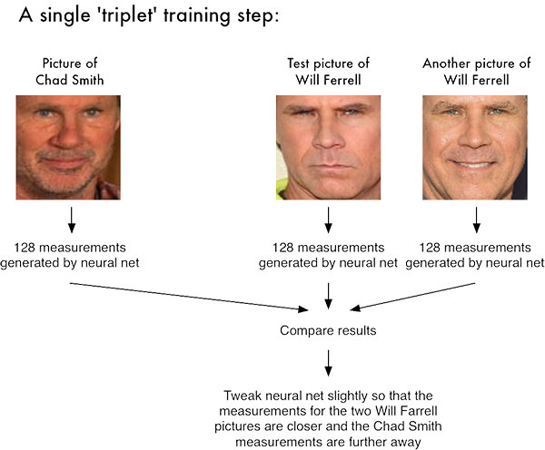

Slide 13
Implicit vs Explicit memory
Based on awareness: (un)conscious recollection
Non-task goals (streaming info right now!)
Explicit memory changes more than implicit
For some patients, either of these are affected

Slide 14
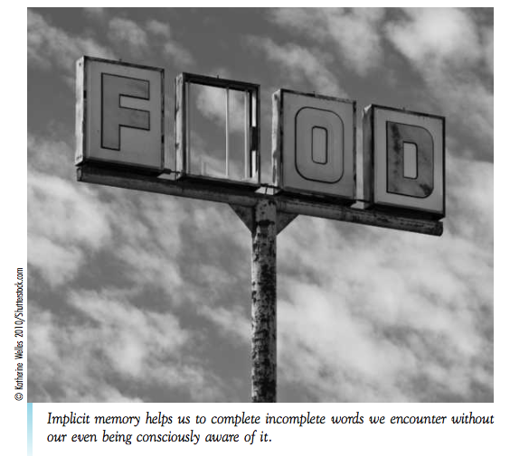
Implicit memory

Slide 15
What is this word?
IMP_ _ _ _
Priming (supraliminal) : Facilitation of the ability to utilize missing information by activating memory
(Subliminal -Not aware): Perform better when words were seen in a list (Tulving, 2000)

Slide 16
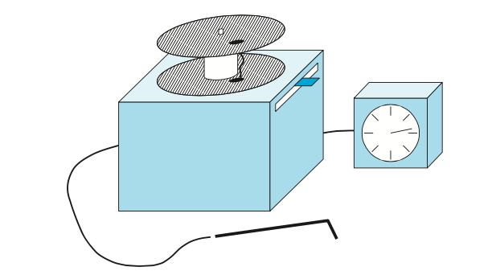
Real-life implicit memory:
Procedural memory
Steps to tie shoe lace or change gears or walk
Motor co-ordination

Slide 17
Conceptualizing memory:
Basic idea
Sensory memory: Brief percepts and sensation
Primary memory: Temporary information currently in use
Secondary memory: Holds information permanently or atleast for a long time

Slide 18
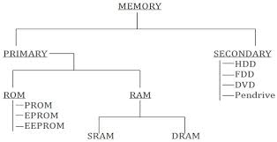
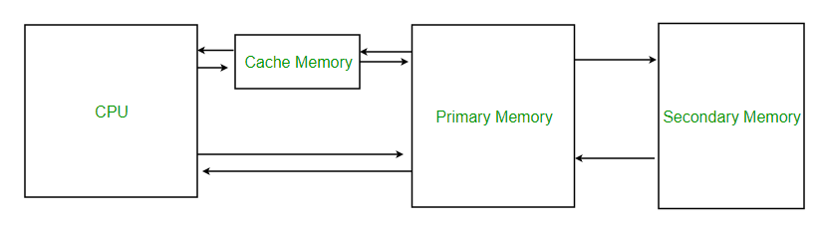
Computer Organization

Slide 19
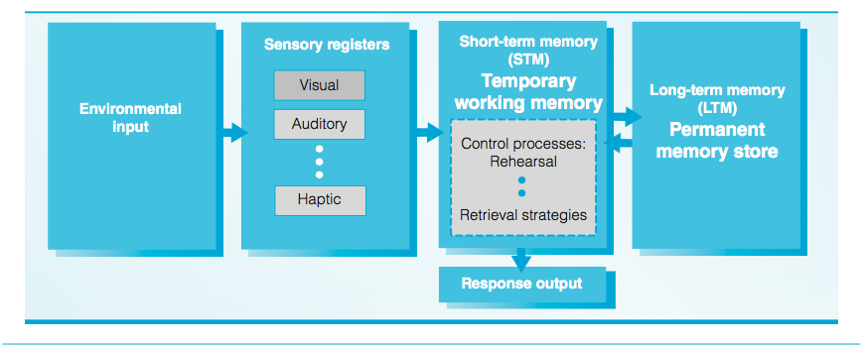
Models of memory:
Three store model (Atkinson & Shiffrin)

Slide 20
Going beyond
Memory in everyday life – preferences, decisions and living
Social memory
Collective memory
Social perception
13/09/21

